Slide 1

Implementation of the Actuator Disk model in
CEASIOMpy for the simulation of propeller aircraft
Giacomo Benedetti
Supervisors: Prof. A. Bottaro
Dr. Jan B. Vos
Co-supervisor: Eng. A. Jungo
Genova, 29/03/2023
Corso di Laurea Magistrale in Ingegneria Meccanica – Energia ed Aeronautica
Curriculum Aeronautica, A.A 2021/2022
Master Thesis Defense

Slide 2



Implementation of the Actuator Disk model in
CEASIOMpy for the simulation of propeller aircraft
Partner
CFS (Computational Fluid and Structure) Engineering
Lausanne, Switzerland
Project Related
Collaborative System of Systems Exploration of Aviation Products, Services & Business models
Giacomo Benedetti

Slide 3
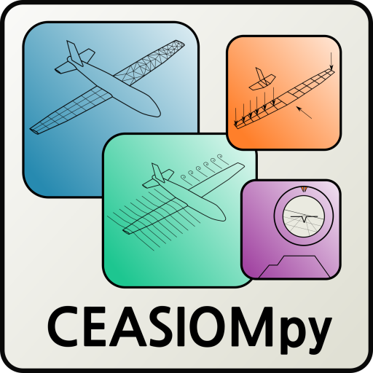
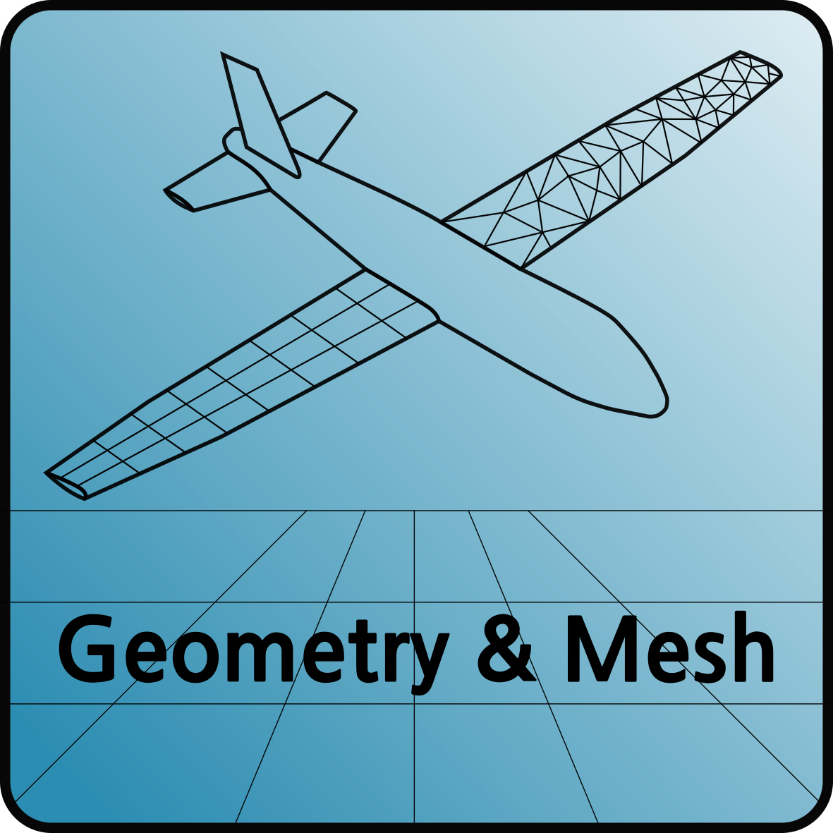
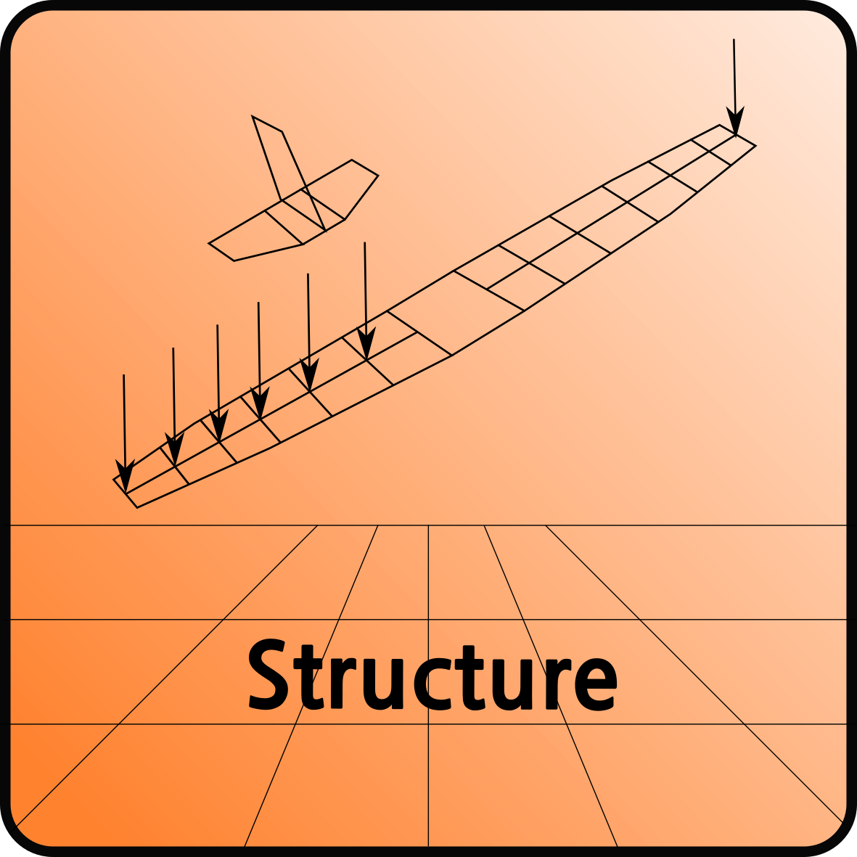

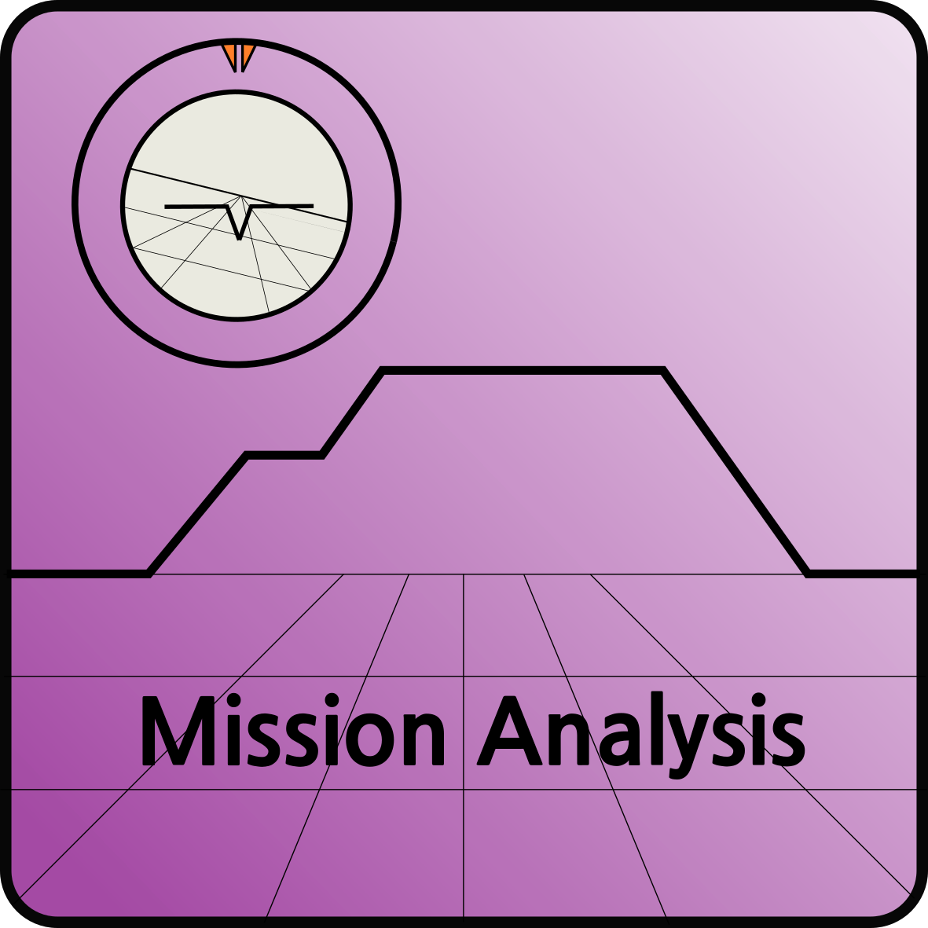
Implementation of the Actuator Disk model in
CEASIOMpy for the simulation of propeller aircraft
Software
NSMB
Navier-Stokes Multi-Blocks
CEASIOMpy:
"open source conceptual aircraft design environment"
Giacomo Benedetti

Slide 4
Implementation of the Actuator Disk model in
CEASIOMpy for the simulation of propeller aircraft
CEASIOMpy:
"open source conceptual aircraft design environment"
Geometry & Mesh module to create the aircraft and its components with the possibility of using the automesh tool.
Structure module (not yet developed) that will provide structural analysis tool
Mission Analysis module to simulate the flight of an aircraft, taking into account of fuel consumption, altitude and weather conditions
Aerodynamics the most important and developed module, there are many tools within the module to perform both vortex lattice method and CFD simulations.
Giacomo Benedetti

Slide 5



Implementation of the Actuator Disk model in
CEASIOMpy for the simulation of propeller aircraft
CEASIOMpy:
CPACS, "Common Parametric Language for Aircraft Design", was used during the project to design the geometry
GMSH, a tool in CEASIOMpy environment to have an automatic mesh
SU2, open source CFD code used to perform Euler simulations during the project
Giacomo Benedetti

Slide 6
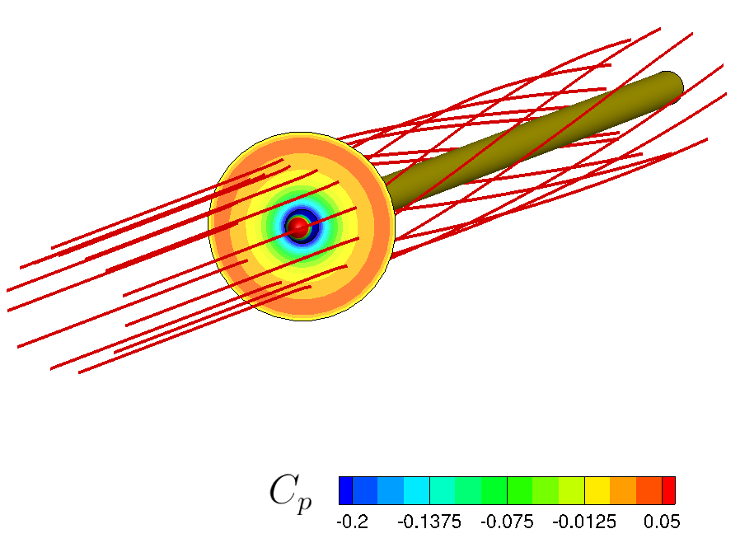
Implementation of the Actuator Disk model in
CEASIOMpy for the simulation of propeller aircraft
Objective
Implementation of a model to consider the presence of the propeller for CFD calculations
Giacomo Benedetti

Slide 7
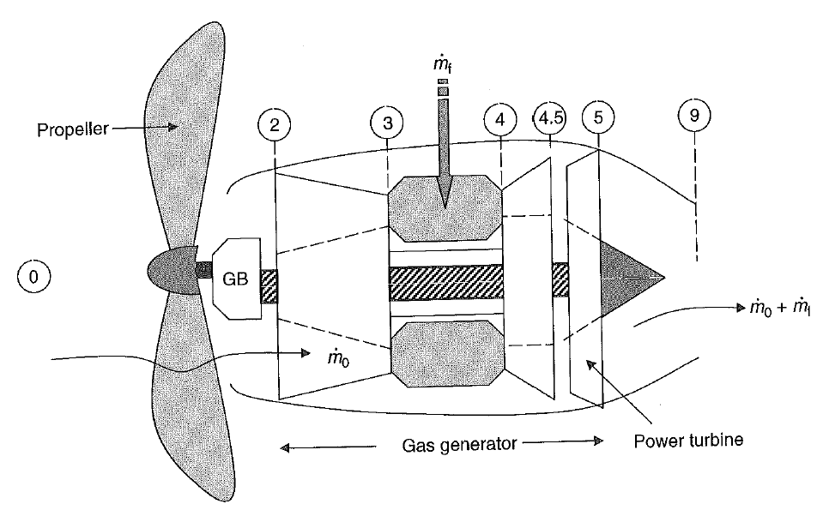
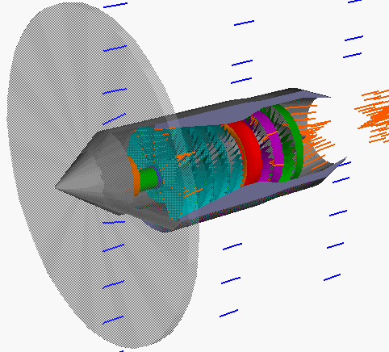
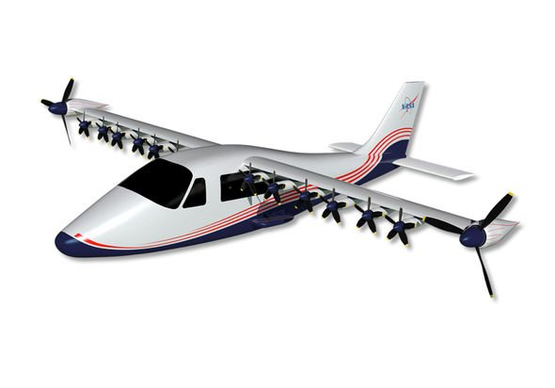



Implementation of the Actuator Disk model in
CEASIOMpy for the simulation of propeller aircraft
Thrust generation
$$T_{total}=T_{core}+T_{propeller}$$
$$≅10\% T_{total}$$
Majority
$T_{core}=\left({\dot{m}}_{0}+{\dot{m}}_{f}\right)V_{9}−(p_{9}−p_{0})A_{9}$
$T_{propeller} ?$
Giacomo Benedetti

Slide 8
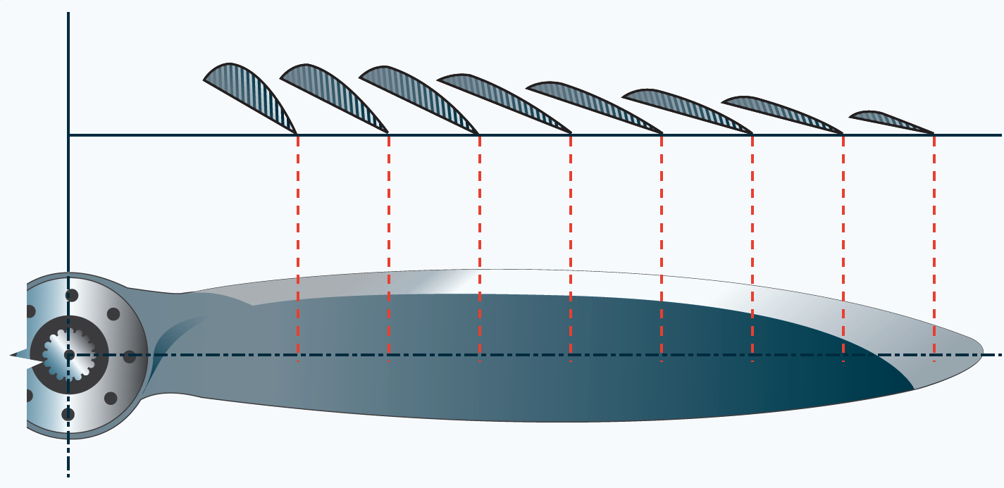
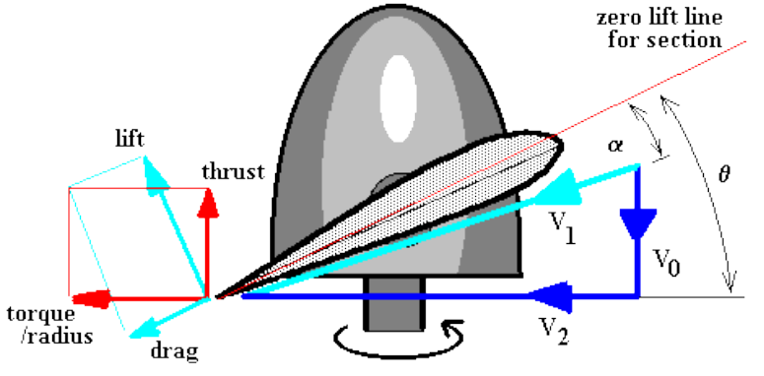
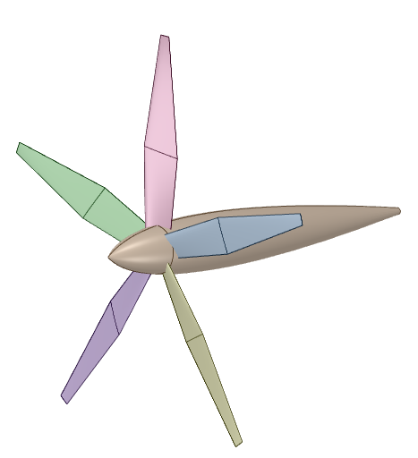
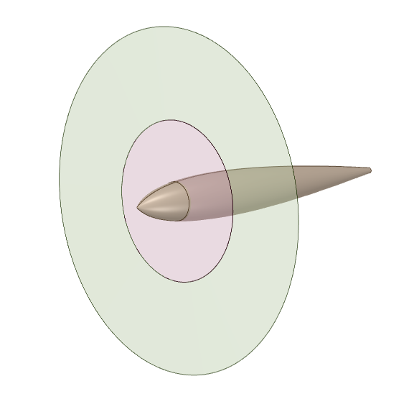
Implementation of the Actuator Disk model in
CEASIOMpy for the simulation of propeller aircraft
Propeller thrust calculation
Main theories:
Blade element theory
Actuator disk theory
Giacomo Benedetti

Slide 9
Implementation of the Actuator Disk model in
CEASIOMpy for the simulation of propeller aircraft
Actuator disk theory vs Blade element theory
Input data
Free stream velocity
Rotational velocity of the propeller
Altitude
Total thrust
Disk radius
Number of blades
Input data
Free stream velocity
Rotational velocity of the propeller
Altitude
Chord distribution
Twist distribution
Disk radius
Number of blades
Giacomo Benedetti

Slide 10
Implementation of the Actuator Disk model in
CEASIOMpy for the simulation of propeller aircraft
Actuator disk theory vs Blade element theory
Input data
Free stream velocity
Rotational velocity of the propeller
Altitude
Total thrust
Disk radius
Number of blades
Input data
Free stream velocity
Rotational velocity of the propeller
Altitude
Chord distribution
Twist distribution
Disk radius
Number of blades
Giacomo Benedetti

Slide 11
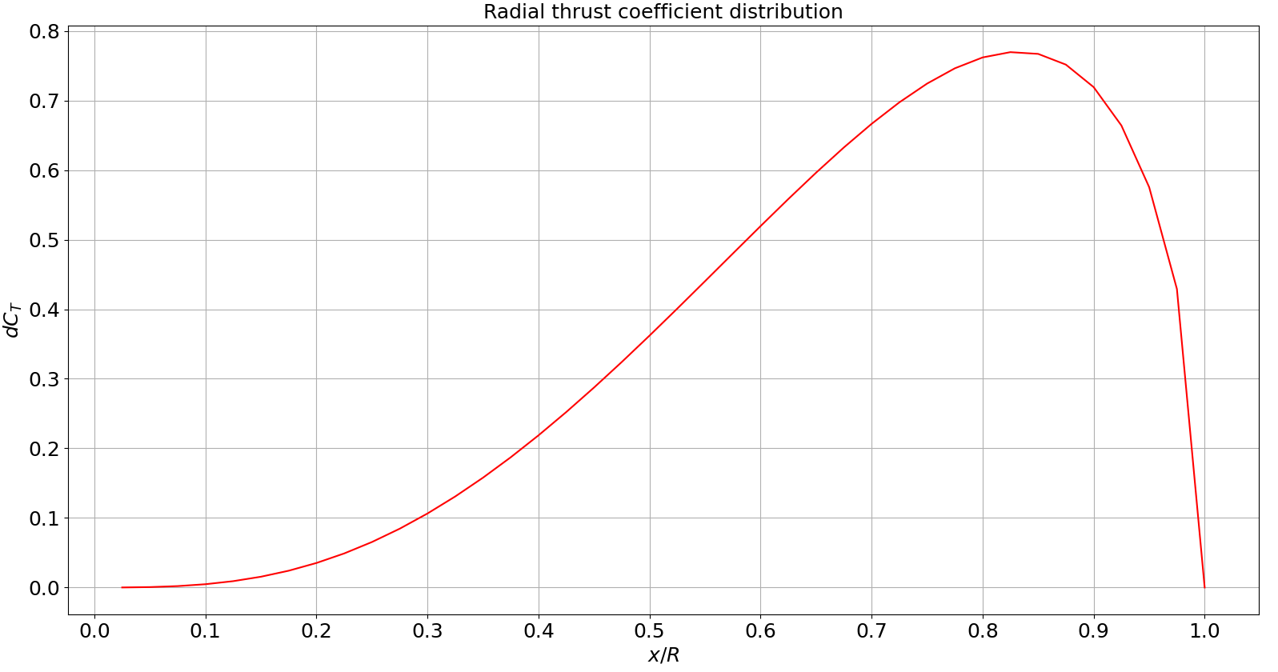

Implementation of the Actuator Disk model in
CEASIOMpy for the simulation of propeller aircraft
Thrust calculation
Python script based on the Actuator Disk Theory
Input data
Free stream velocity
Rotational velocity of the propeller
Altitude
Total thrust
Disk radius
Number of blades
Thrust and power distributions
along the radius
Giacomo Benedetti

Slide 12
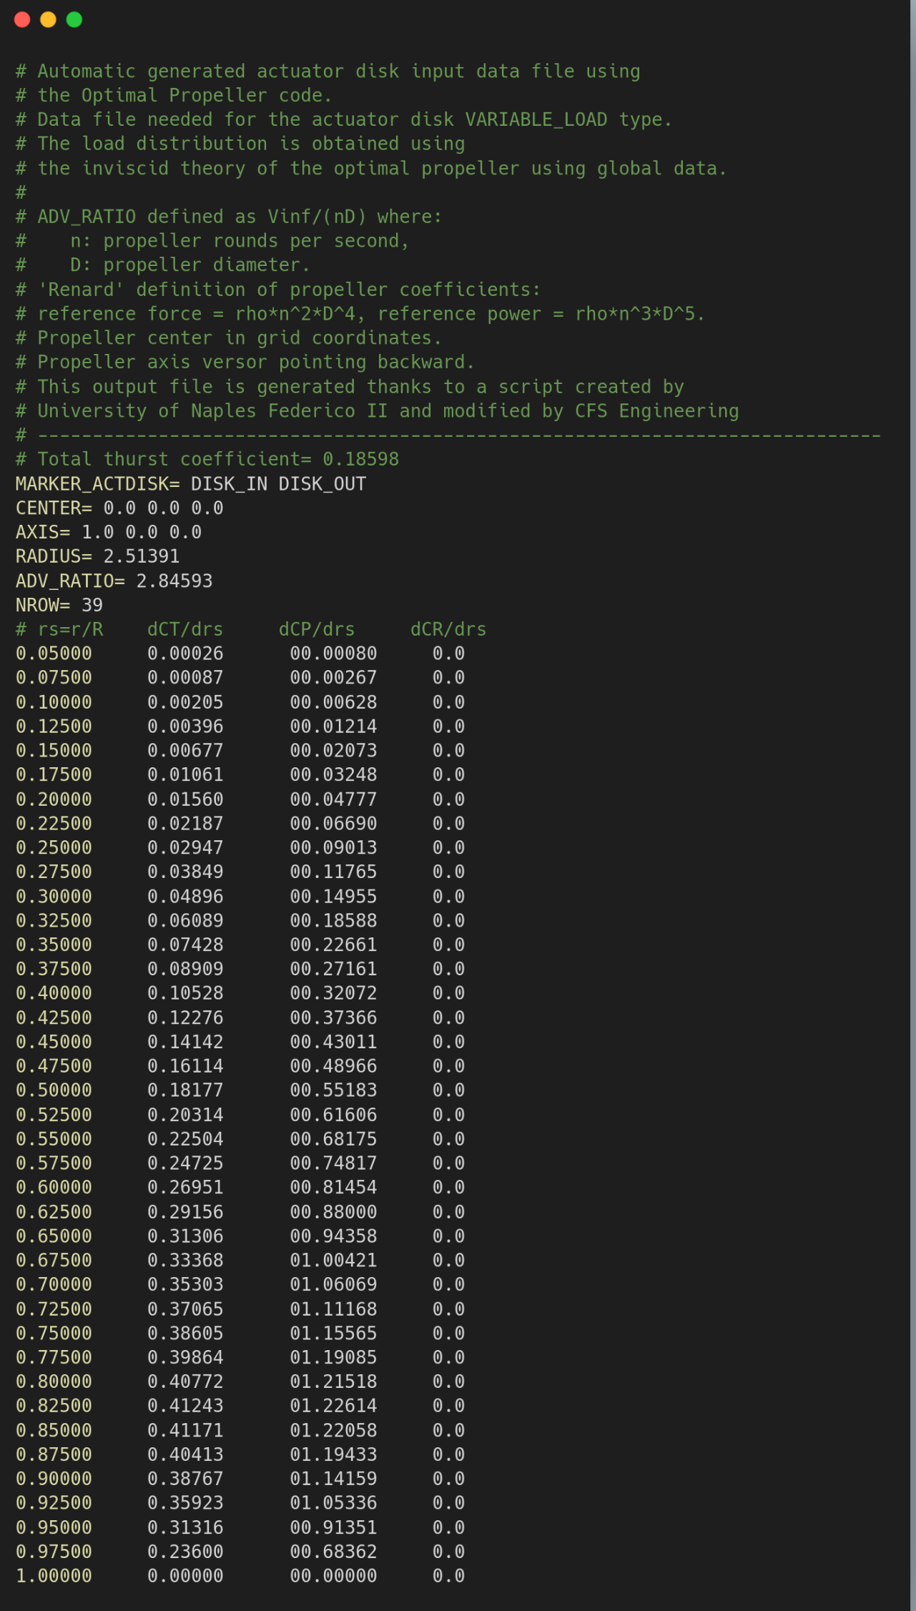
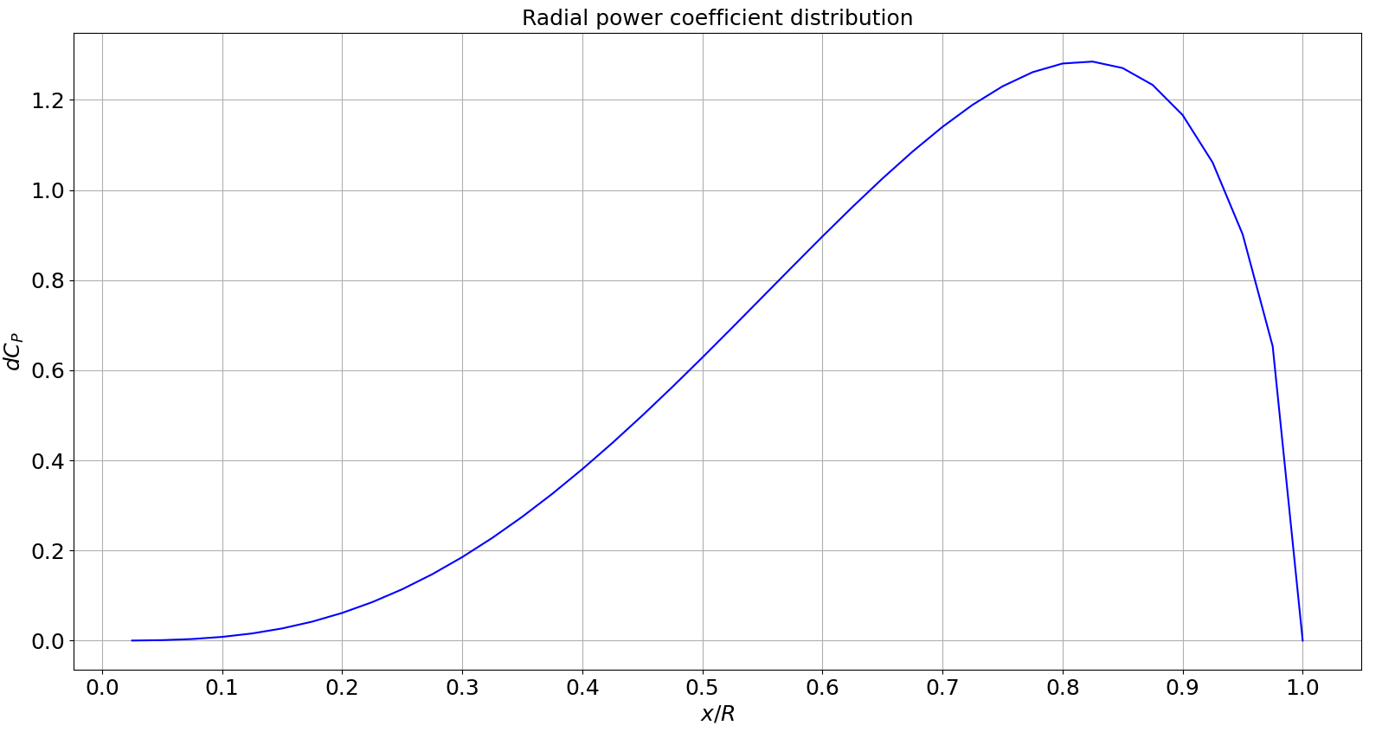
Implementation of the Actuator Disk model in
CEASIOMpy for the simulation of propeller aircraft
Thrust calculator script
.dat file generation
with
thrust and power distribution
Giacomo Benedetti

Slide 13
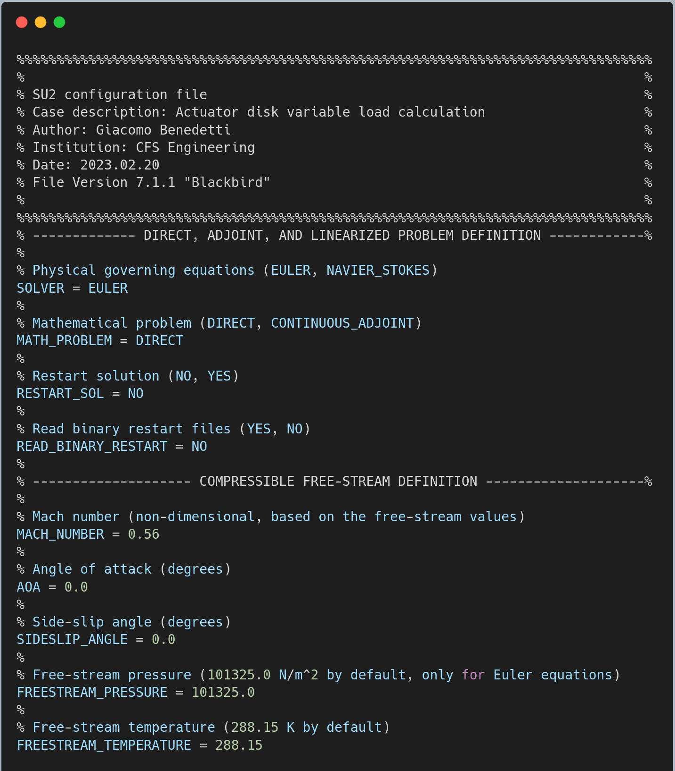
Implementation of the Actuator Disk model in
CEASIOMpy for the simulation of propeller aircraft
CEASIOMpy:
"open source conceptual aircraft design environment"
.dat file read by configuration file of the CFD solver
Giacomo Benedetti

Slide 14
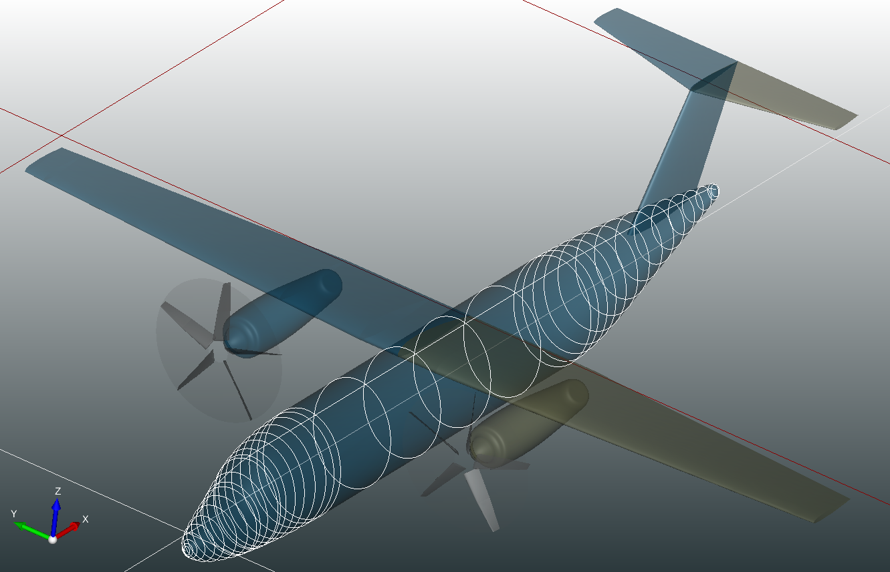
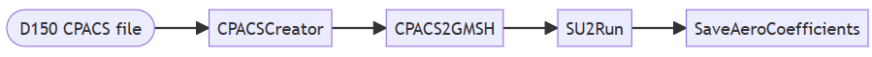
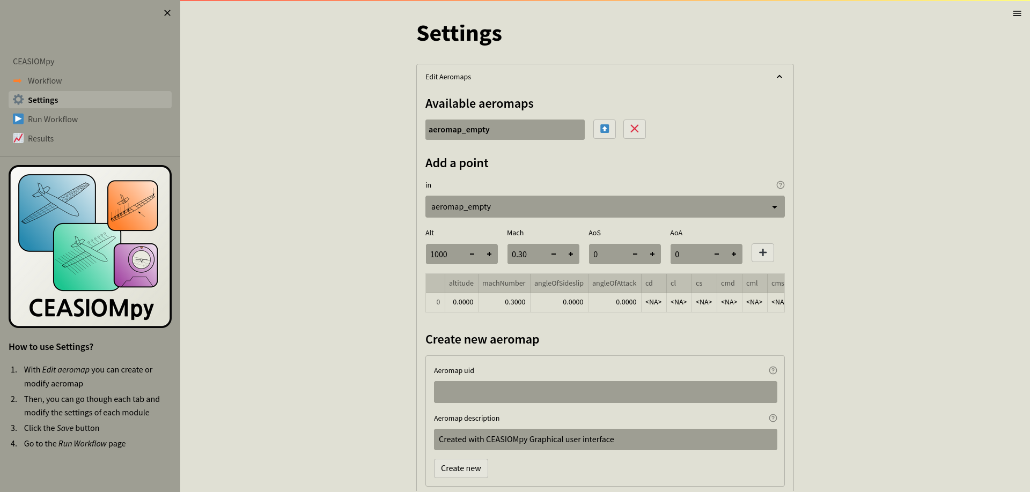
Implementation of the Actuator Disk model in
CEASIOMpy for the simulation of propeller aircraft
Choice of geometry
Choice of the modules
Module setting
Parameters to perform the simulation are set
Run simulation
CFD calculation using Euler equations
Giacomo Benedetti

Slide 15
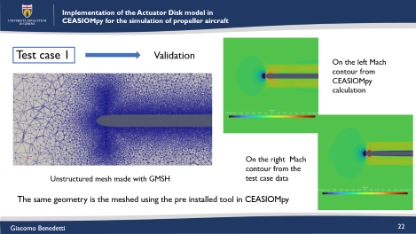
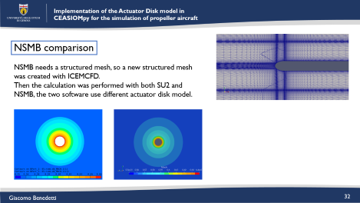
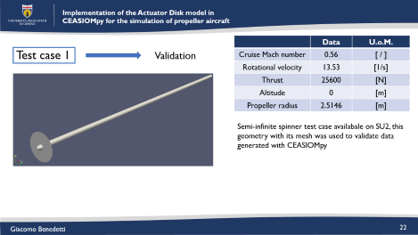
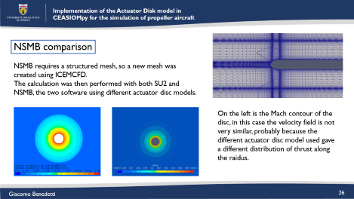
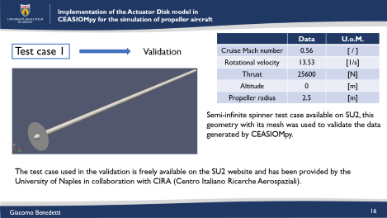
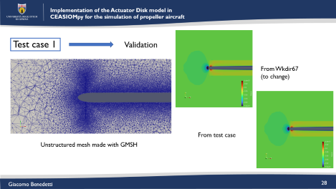
Implementation of the Actuator Disk model in
CEASIOMpy for the simulation of propeller aircraft
VALIDATION
Giacomo Benedetti
Notes:
O abbasso immagini oppure aggiungo una scritta

Slide 16
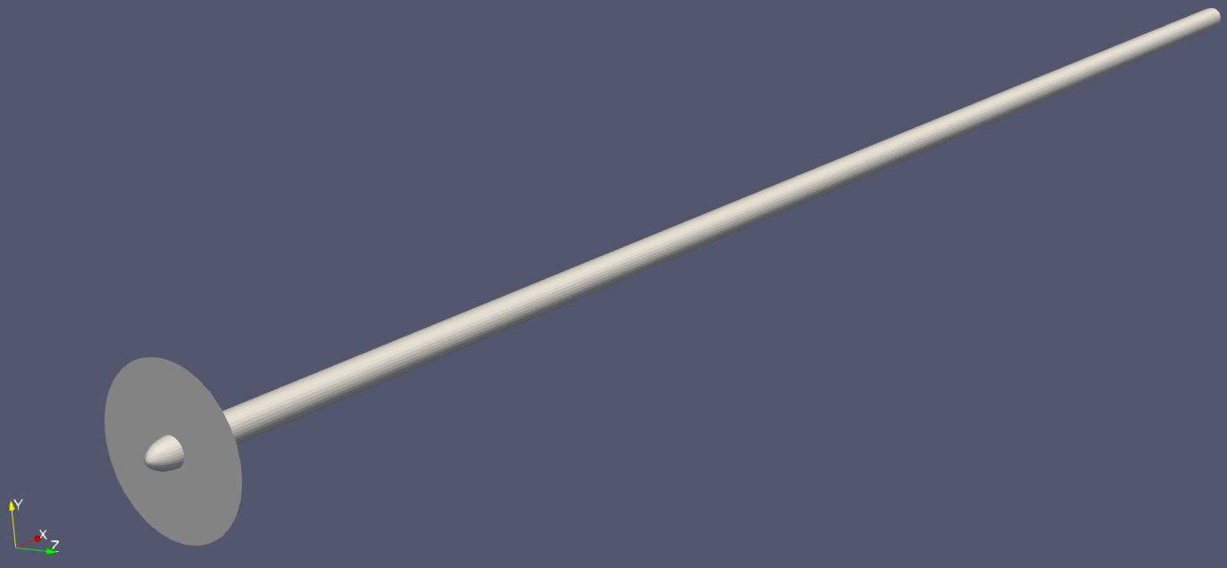
Implementation of the Actuator Disk model in
CEASIOMpy for the simulation of propeller aircraft
 | Data | U.o.M.
Cruise Mach number | 0.56 | [ / ]
Rotational velocity | 13.53 | [1/s]
Thrust | 25600 | [N]
Altitude | 0 | [m]
Propeller radius | 2.5 | [m]
Test case 1
Validation
Semi-infinite spinner test case available on SU2, this geometry with its mesh was used to validate the data generated by CEASIOMpy.
The test case used in the validation is freely available on the SU2 website and has been provided by the University of Naples in collaboration with CIRA (Centro Italiano Ricerche Aerospaziali).
Giacomo Benedetti
Notes:
O abbasso immagini oppure aggiungo una scritta

Slide 17
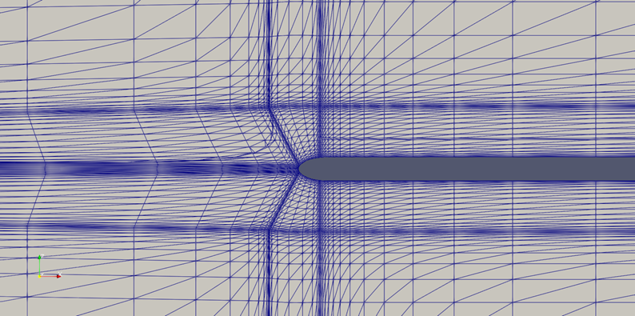
Implementation of the Actuator Disk model in
CEASIOMpy for the simulation of propeller aircraft
 | Data | U.o.M.
Cruise Mach number | 0.56 | [ / ]
Rotational velocity | 13.53 | [1/s]
Thrust | 25600 | [N]
Altitude | 0 | [m]
Propeller radius | 2.5 | [m]
Test case 1
Validation
Semi-infinite spinner test case available on SU2, this geometry with its mesh was used to validate the data generated by CEASIOMpy.
Structured SU2 tutorial mesh
The .dat file with the thrust distribution is generated with CEASIOMpy
Giacomo Benedetti

Slide 18
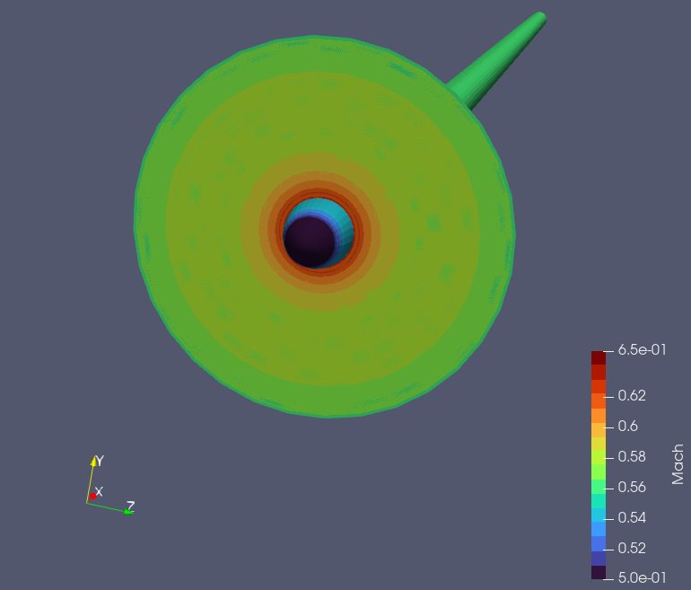
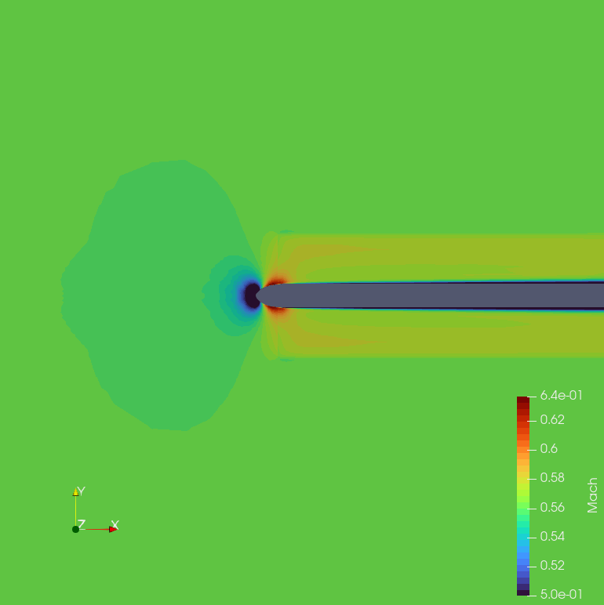
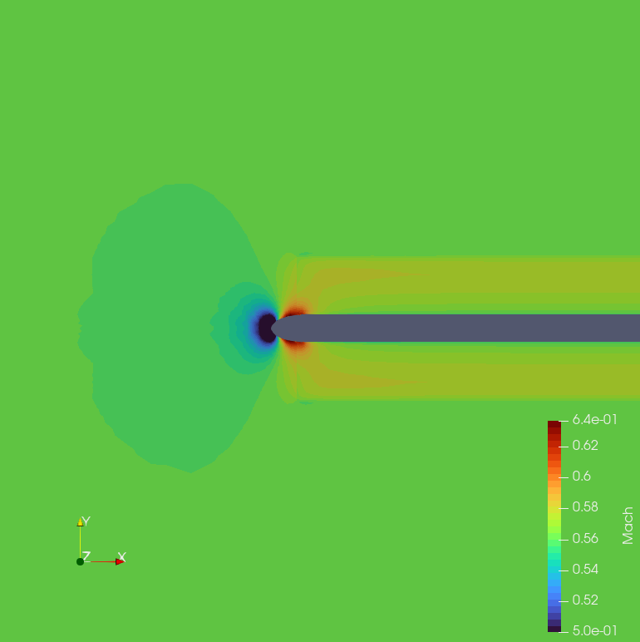
Implementation of the Actuator Disk model in
CEASIOMpy for the simulation of propeller aircraft
Test case 1
CEASIOMpy generated .dat file for Euler calculation
Mach contour on the disk
It is possible to see how the velocity changes on the disk and both upstream and downstream of it.
Mach contour from SU2 tutorial
(RANS simulation)
Mach contour calculated
(Euler simulation)
Giacomo Benedetti

Slide 19
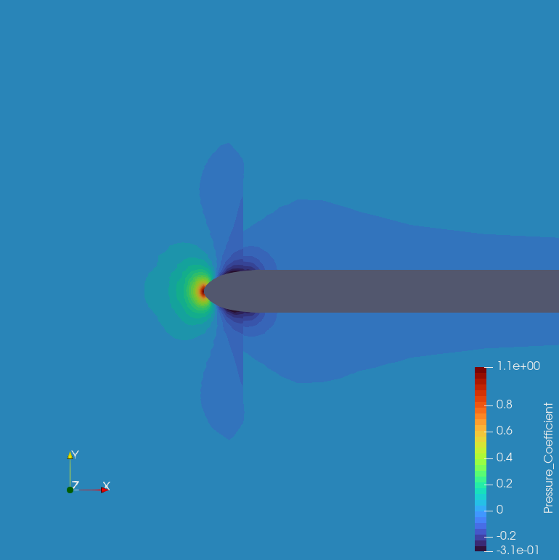
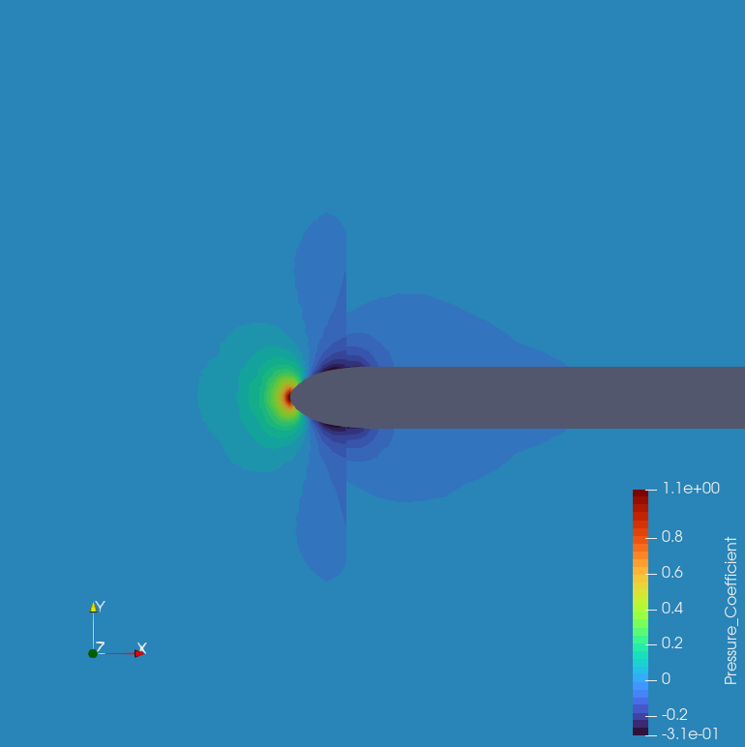
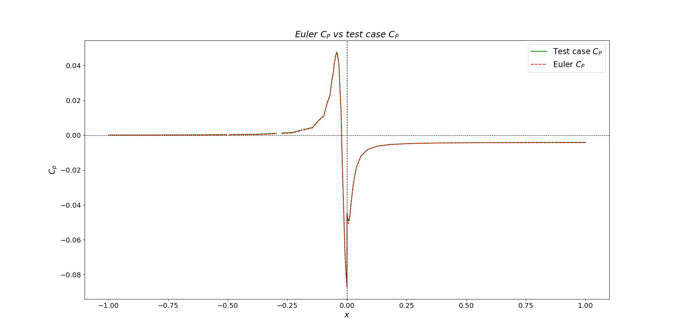
Implementation of the Actuator Disk model in
CEASIOMpy for the simulation of propeller aircraft
Test case 1
CEASIOMpy generated .dat file for Euler calculation
The contours are very similar, except for a small difference downstream of the disc, probably due to the use of a non-viscous theory. To better observe the trend, it is useful to plot the pressure coefficient on a line
Line of the plot
DISK
Line of the plot
DISK
Pressure coefficient contour from SU2 tutorial
(RANS simulation)
Pressure coefficient contour calculated
(Euler simulation)
Giacomo Benedetti

Slide 20
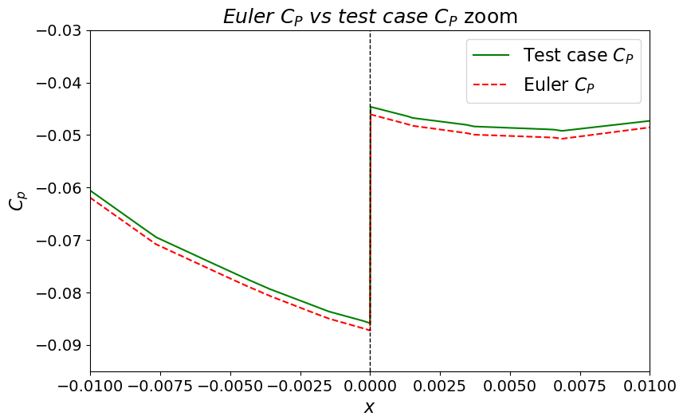
Implementation of the Actuator Disk model in
CEASIOMpy for the simulation of propeller aircraft
Test case 1
Pressure coefficient plotted on a line parallel to the x-direction
Zoom in the disk zone
The differences in this simulation are almost zero, the pressure jumps are overlapped, as in the other part of the plot
Giacomo Benedetti

Slide 21
Implementation of the Actuator Disk model in
CEASIOMpy for the simulation of propeller aircraft
VALIDATION
Giacomo Benedetti

Slide 22
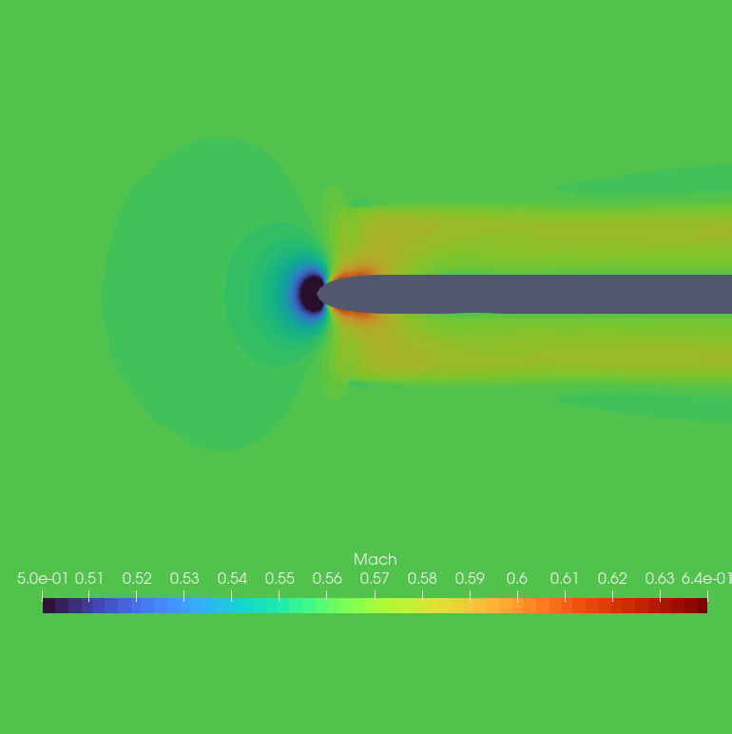
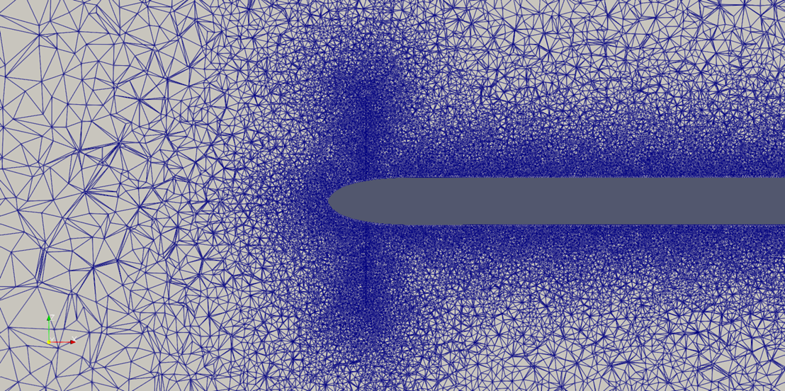
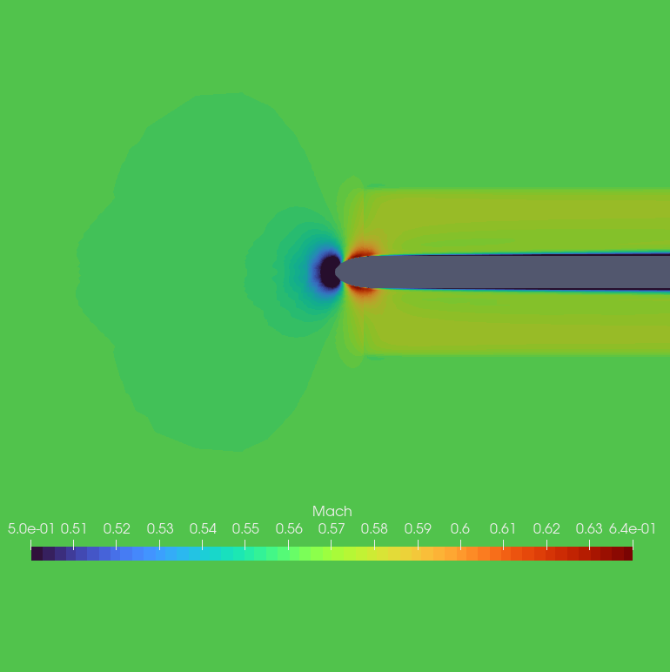
Implementation of the Actuator Disk model in
CEASIOMpy for the simulation of propeller aircraft
Test case 1
Validation
On the left Mach contour from CEASIOMpy calculation
On the right Mach contour from the test case data
Unstructured mesh made with GMSH
The same geometry is the meshed using the pre installed tool in CEASIOMpy
Giacomo Benedetti

Slide 23
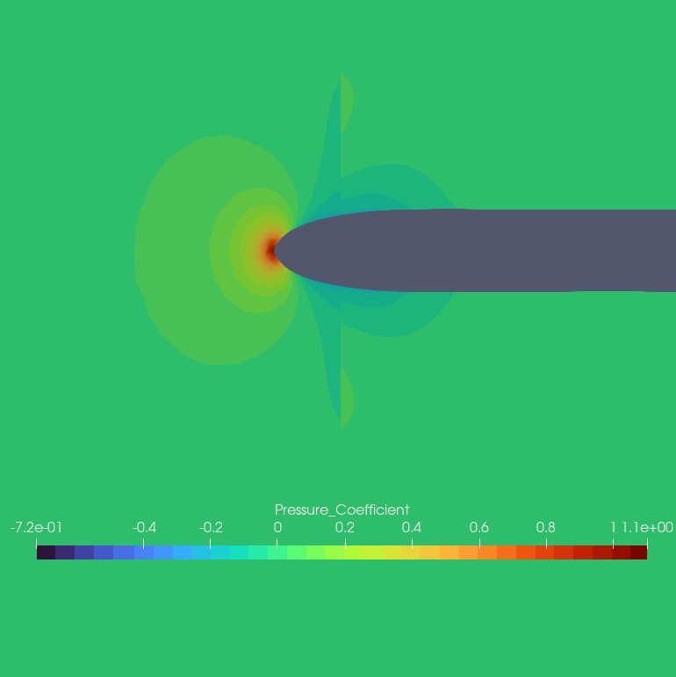
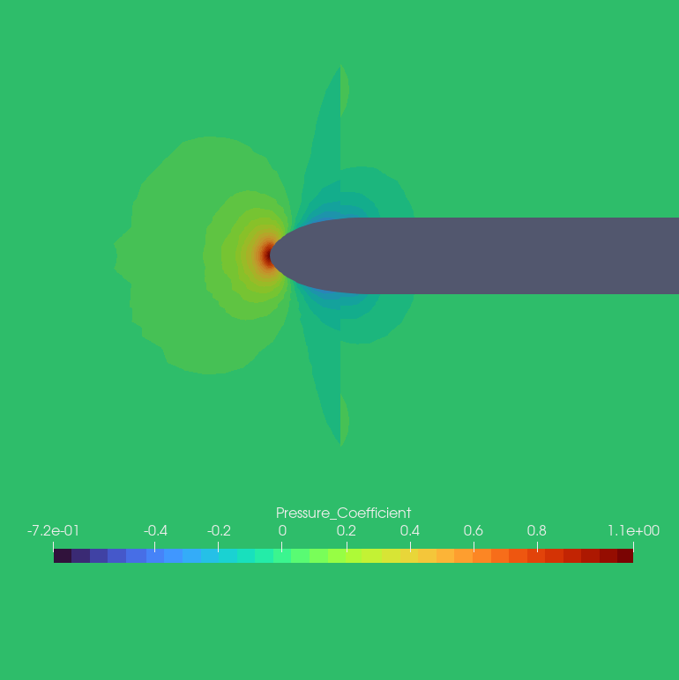
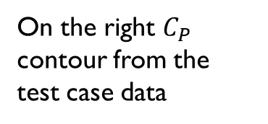
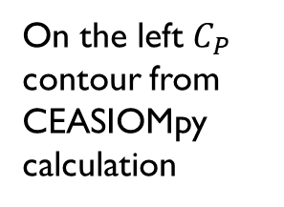
Implementation of the Actuator Disk model in
CEASIOMpy for the simulation of propeller aircraft
Test case 1
Validation
On the left $C_{P}$ contour from CEASIOMpy calculation
DISK
Line of the plot
On the right $C_{P}$ contour from the test case data
Unstructured mesh made with GMSH
The same geometry is the meshed using the pre installed tool in CEASIOMpy
Giacomo Benedetti

Slide 24
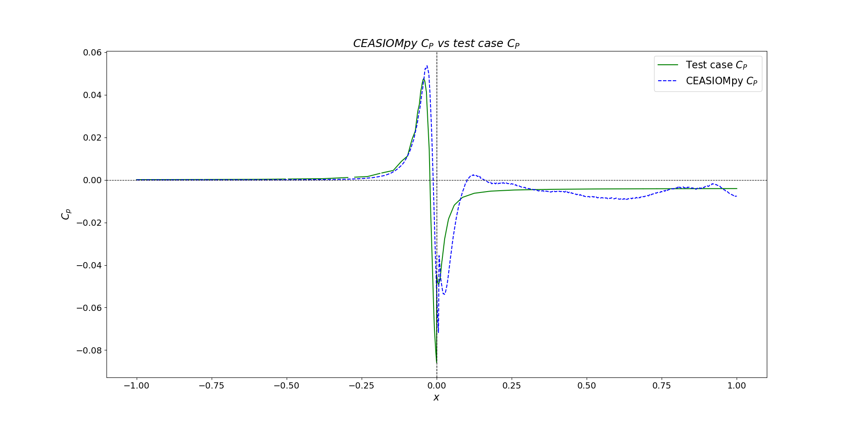
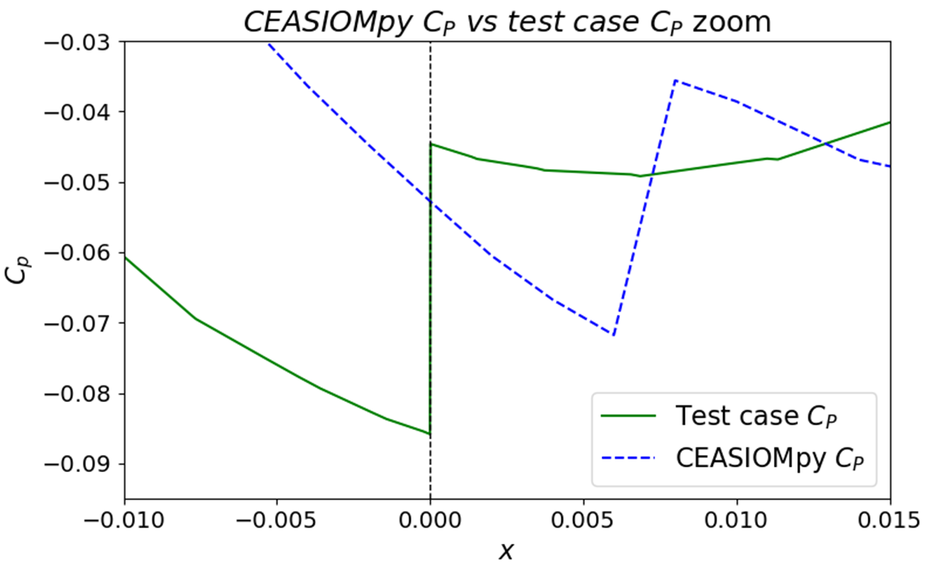


Implementation of the Actuator Disk model in
CEASIOMpy for the simulation of propeller aircraft
Test case 1
$$x/x_{max}$$
$$x/x_{max}$$
Pressure coefficient plotted on a line parallel to the x-direction
Zoom in the disk zone
Compared to the previous simulation, there are some small differences in this case, the pressure jump is not well located, and it is not vertical, probably due to the use of different mesh (structured and unstructured)
Giacomo Benedetti

Slide 25
Implementation of the Actuator Disk model in
CEASIOMpy for the simulation of propeller aircraft
VALIDATION
Giacomo Benedetti

Slide 26
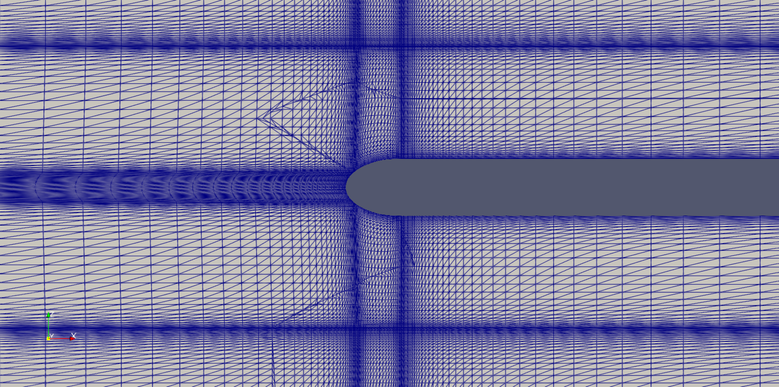
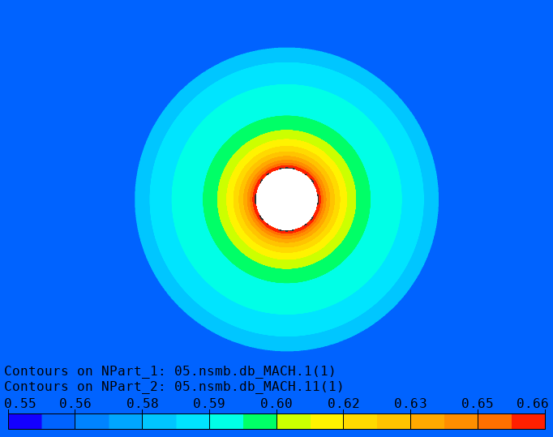
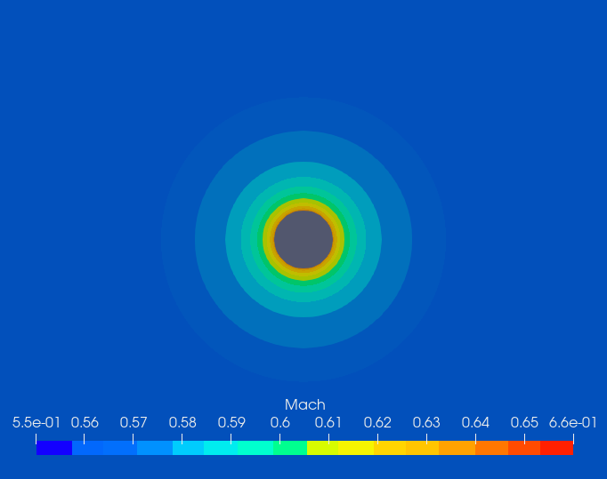
Implementation of the Actuator Disk model in
CEASIOMpy for the simulation of propeller aircraft
NSMB comparison
NSMB requires a structured mesh, so a new mesh was created using ICEMCFD.
The calculation was then performed with both SU2 and NSMB, the two software using different actuator disc models.
On the left is the Mach contour of the disc, in this case the velocity field is not very similar, probably because the different actuator disc model used gave a different distribution of thrust along the raidus.
Giacomo Benedetti

Slide 27
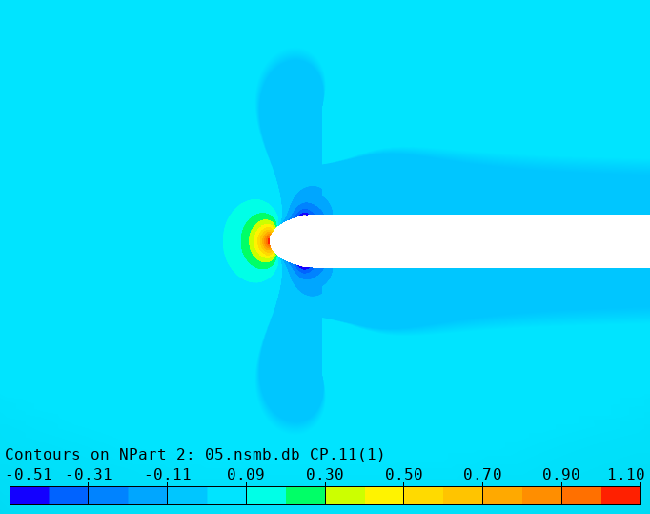
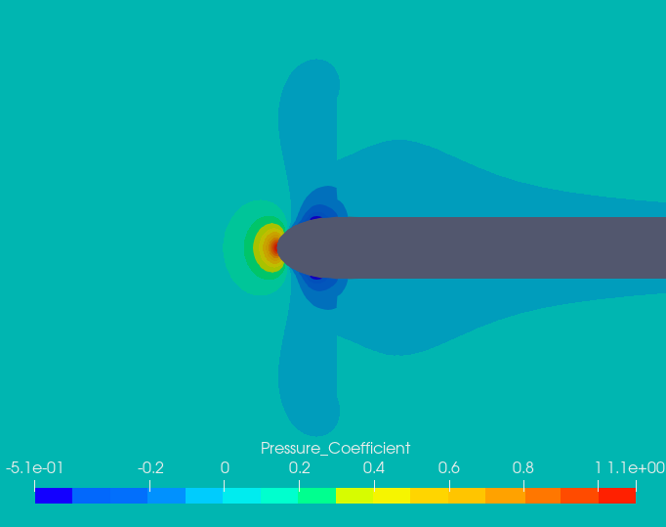
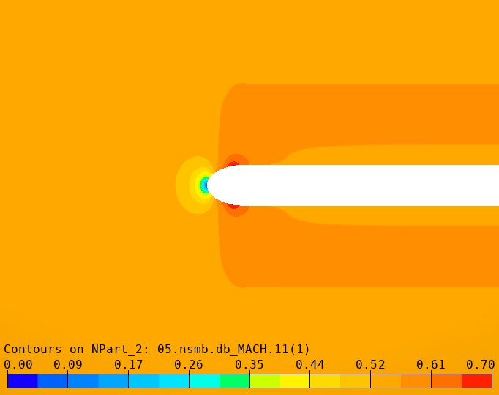
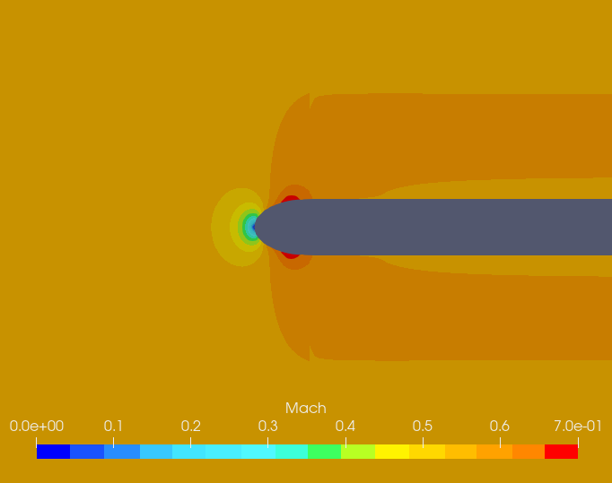
Implementation of the Actuator Disk model in
CEASIOMpy for the simulation of propeller aircraft
NSMB comparison
Looking at the side, it is possible to observe the comparison between the pressure coefficient distribution, the results are very similar, the main difference is downstream where the contour is quite different, probably due to the different choice of solver.
In terms of velocity fields, looking at the contours on the left, there are no significant differences.
Giacomo Benedetti

Slide 28



Implementation of the Actuator Disk model in
CEASIOMpy for the simulation of propeller aircraft
Simulations
Different geometry were tested to investigate the behaviour and the robustness
Giacomo Benedetti

Slide 29
Implementation of the Actuator Disk model in
CEASIOMpy for the simulation of propeller aircraft
Wing and propeller simulation
 | Data | U.o.M.
Cruise Mach number | 0.3 | [ / ]
Rotational velocity | 55 | [1/s]
Thrust | 4000 | [N]
Altitude | 0 | [m]
Propeller radius | 0.66 | [m]
A further step was taken, instead of looking only at the propeller behaviour, the wing was added and several simulations were carried out.
This time it was decided to change the parameters, which were taken according to the availability of online data.
Giacomo Benedetti

Slide 30




Implementation of the Actuator Disk model in
CEASIOMpy for the simulation of propeller aircraft
Wing and propeller simulation
In this case, the propeller rotation velocity is higher, as can be seen from the contours above. As for the pressure drop (contour on the right), in this case there is an oscillation downstream of the disk, probably due to the automatic mesh generation.
Giacomo Benedetti

Slide 31



Implementation of the Actuator Disk model in
CEASIOMpy for the simulation of propeller aircraft
Wing and propeller simulation
DISK
Oscillation is probably due to the mesh
Line of the plot
Giacomo Benedetti

Slide 32



Implementation of the Actuator Disk model in
CEASIOMpy for the simulation of propeller aircraft
Wing and propeller simulation
Regarding the velocity contour, this slide shows the results. The first contour (a) shows how the velocity field changes in correspondence of the disk, instead from the contour (b) and (c) can be seen how the velocity changes along the radius.
Mach contour (a)
Mach contour (b)
Mach contour (c)
Giacomo Benedetti

Slide 33


Implementation of the Actuator Disk model in
CEASIOMpy for the simulation of propeller aircraft
CONCLUSION AND FUTURE DEVELOPMENT
Results provide first insights
Low fidelity
Low computing cost
Mesh has to be improved
Handy
RANS has to be added
Good starting point for what will be done in COLOSSUS project
Giacomo Benedetti

Slide 34


Implementation of the Actuator Disk model in
CEASIOMpy for the simulation of propeller aircraft
CONCLUSION AND FUTURE DEVELOPMENT
The tool will be developed in the context of the COLOSUSS (Collaborative System of Systems Exploration of Aviation Products, Services and Business Models) project, with the aim of developing AAM (Advanced Air Mobility), i.e. seaplanes and Multi-Role eVTOLs, in particular to:
Improve the mesh
Made accurate sensitivity analysis
Giacomo Benedetti

Slide 35

Implementation of the Actuator Disk model in
CEASIOMpy for the simulation of propeller aircraft
Thank you for your attention
Giacomo Benedetti

